Slide 1
2023-24 FAME Teacher’s Meeting
Cultural Focus: Scandinavia

Slide 2
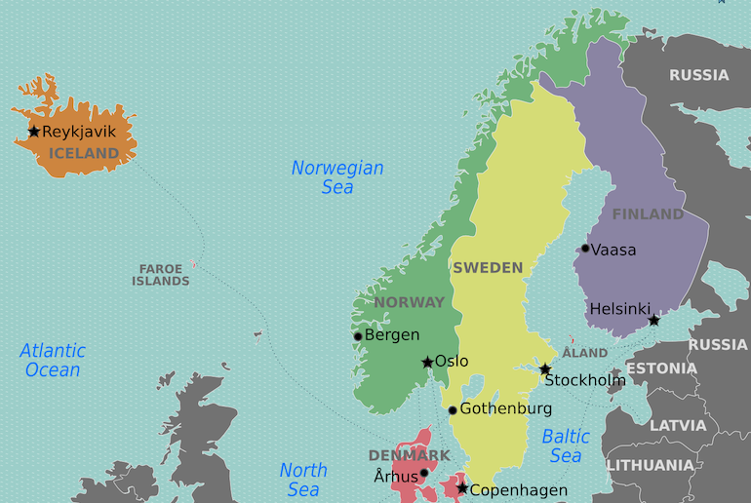
Scandinavia
Sweden
Norway
Finland
Denmark
Iceland
Faroe Islands (Denmark)
Greenland (Denmark)

Slide 3
Fjäskern (Sweden)
Teaching Movement and Dance by Phyllis Weikart
Also called “Hurry Scurry”
https://www.youtube.com/watch?v=B50Awwhuwxc
On Rhythmically Moving CD 2 or Shenanigans

Slide 4
Undir grønum lí­ðum (Faroe Islands)
Under the green hills
Undir grønum líðum, har goymi eg ringin, sært tú, eg havi ongan, men hvør hevur hann?
Under the green hills, I hide the ring. You see I don’t have one, but who has it?
https://www.nordicsounds.info/app/#/0/search/details/212

Slide 5
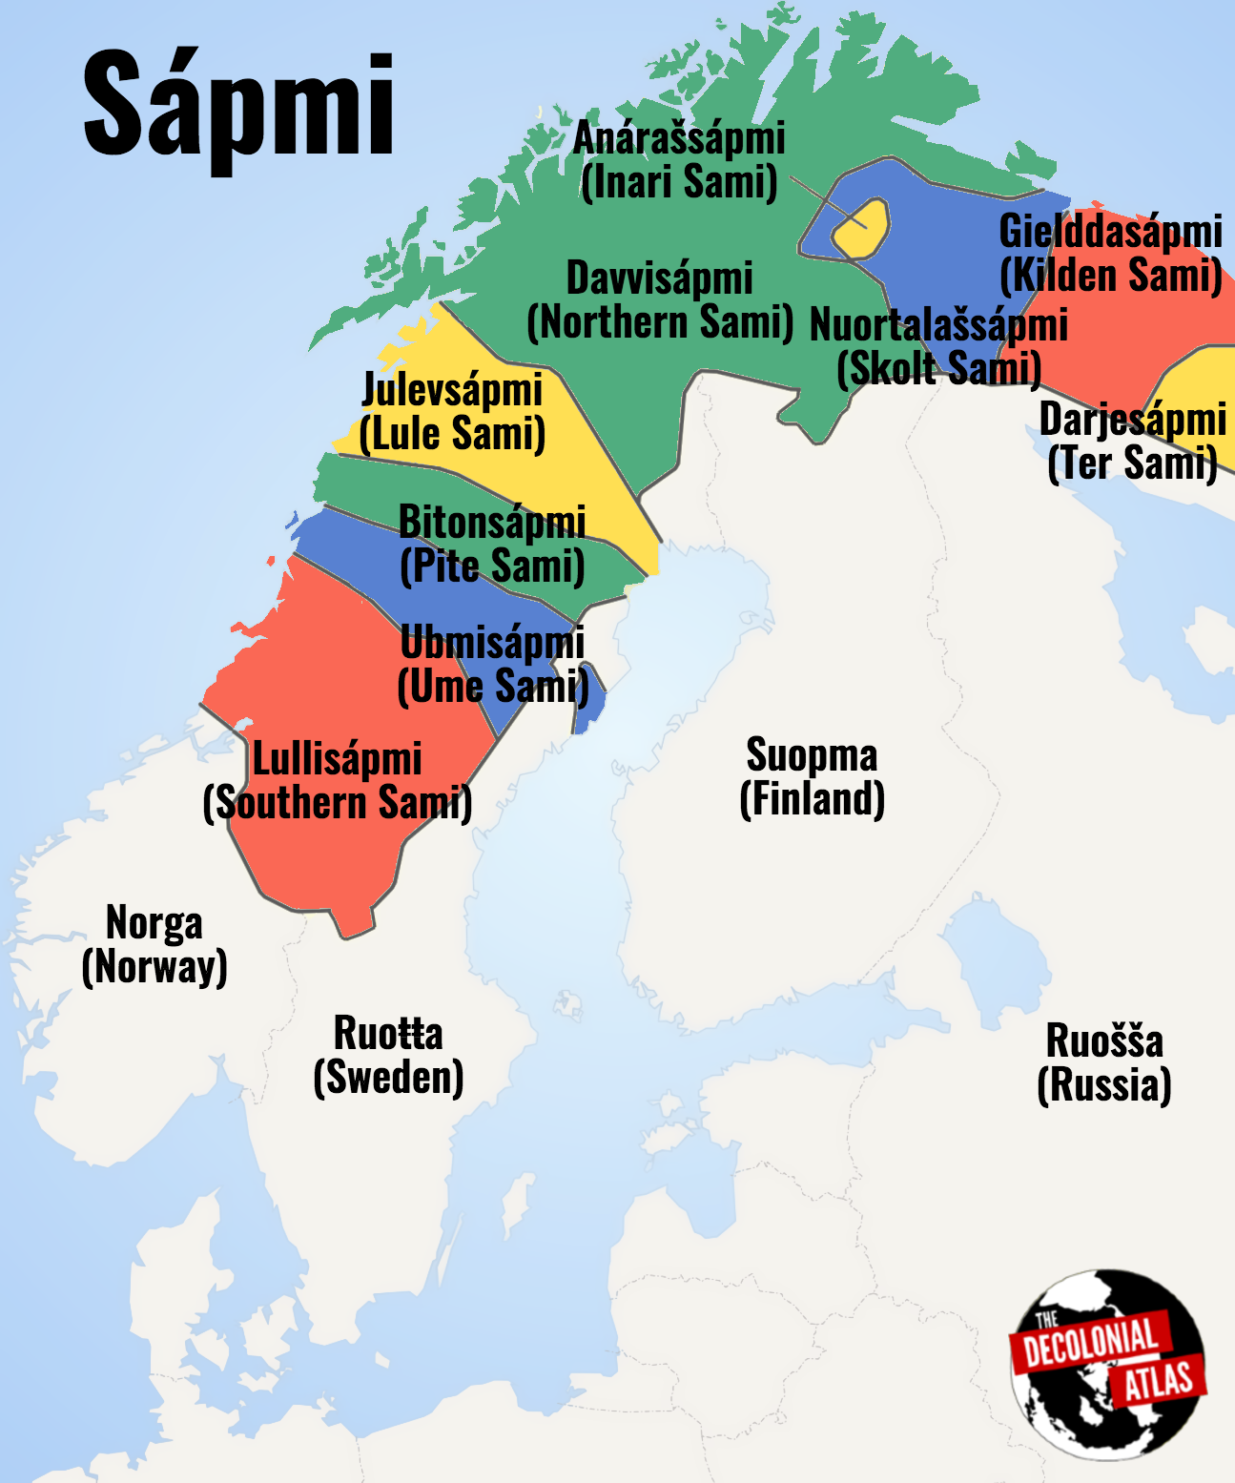
Kuovsâkkâsah (Sámi)
Modern-composed Sámi livđe
The three Sámi language groups have their own music styles:
North Sámi have joik or luohti
Skolt Sámi have leu’dd
Aanaar Sámi have livđe, which is similar to joik
https://www.nordicsounds.info/app/#/0/search/details/230
The opening song of Frozen called Vuelie and the native people were inspired by the Sámi people – this is in the style of joiking https://www.youtube.com/watch?v=schn6IIJd-U

Slide 6
Onko koira kotona? (Finland)
Finger game
Q: Onko Koira kotona? A: Miesten kanssa mettällä Q: Onko Koira kotona? A: Naisten kanssa navetassa Q: Onko Koira kotona? A: Lasten kanssa leikkimässä Q: Onko Koira kotona? A: HAU!
Q: Is the Dog at home? A: No he’s with the man in the forest Q: Is the Dog at home? A: No he’s with the women in the barn Q: Is the Dog at home? A: No he’s playing with the children Q: Is the Dog at home? A: Hau! (Woof!)
https://www.nordicsounds.info/app/#/0/search/details/7

Slide 7
Pí­laranda (Iceland)
Icelandic Children’s Game
Pílaranda, pílaranda marenkúlaren og tökum Jónas í skaren.
Last line: leysum alla úr skaren.
(nonsense) (nonsense) let’s take Jónas in the crowd Last line: release us all from the crowd.
https://www.nordicsounds.info/app/#/0/search/details/19

Slide 8
Aqaat (Greenland)
Charm song – for someone you love or care about
In Greenland, you often make a personal song for the one you love. These songs do not have a specific form or order. The purpose for this song is to show your love in the melody and the lyric. This can just be a sentence that shows your feeling or a melody with no words or a melody with nonsense words. The main purpose is to show your love for the person in the Aqaat song.
The character of the song can also be a reference to the personality of the receiver.
https://www.nordicsounds.info/app/#/0/search/details/12

Slide 9
Gustav’s Skol (Sweden)
From the New England Dancing Masters collection Sashay the Donut (see packet)
https://www.youtube.com/watch?v=OAkdakV8NEs

Slide 10
Seven Jumps (Denmark)
Danish folk dance, great for younger students
On Shenanigans CD, can find the track on YouTube
https://www.youtube.com/watch?v=X1vbDTbJ0UQ&pp=ygULc2V2ZW4ganVtcHM%3D

Slide 11
Sulla Rulla (Norway)
Norwegian lullaby
In Norwegian folksongs, they sing a lot on the consonants, so emphasize the sound of the L in Sulla rulla.
Eventually place the name of each child into the song instead of using ‘leia’ at the end of each line.
Sing while swaying together. Can be sung in canon. Can be given bordun. See link for extensions.
https://www.nordicsounds.info/app/#/0/search/details/26

Slide 12
Classical Music from Scandinavia
The most well-known works from Scandinavia are Finlandia, by Sibelius and Peer Gynt by Grieg.
Info about them is included in your packet. There are also links on the resource slide for info and activities.

Slide 13
Resources
Book used today: The Tomten by Astrid Lindgren
Nordic Sounds Project
About Grieg and Peer Gynt
Classics for Kids Lessons - Edvard Grieg
Peer Gynt Suite Move It
Peer Gynt Suite Move it with scarf
Peer Gynt Anitra's Dance Move It 1
Peer Gynt Anitra's Dance Move It 2
Peer Gynt Anitra's Dance Professional Dancer
In the Hall of the Mountain King rhythm play along
Mountain King progression movement
Mountain King Dubstep
Mountain King Rhythm Play Along with Accents
Mountain King Body Percussion Demo
Mountain King Body Percussion
Mountain King Boomwhackers
Mountain King Classroom Orchestra
Mountain King Long/Short activity
Mountain King Listening Map
Mountain King Rhythm Play Along with Form
Mountain King Body Percussion Play Along Slower
Mountain King Line Rider
Mr. Delgaudio: Hej, Tomtegubbar

